Slide 1


Moodle Plugin Für Verifiable Credentials
Badges als Sprachnachweise
Übersicht | Ausstellungsprozess | Verifizierungsprozess | Demo
Patrick Herbke, Jonas Krause | Fachgebiet Service-centric Networking | TU Berlin & Telekom Innovation Laboratories
Notes:
Remarks
- Mandatory: Presentation title, presentation structure, name & affiliation
- Title photo can be replaced by another that fits to the presentation (if no appropriate photo is available, go with this one)

Slide 2
1.1 Motivation
Moodle
Über 46 Mio. Kurse
In über 239 Ländern
Open Badges
Digitale Sprachnachweise für Studierende als Verifiable Credentials
MOODLE PLUGIN FÜR VC | JONAS KRAUSE | 25. SEPTEMBER 2023
Notes:
Slide with one picture
Remarks:
picture is to be placed preferably on the left hand side
picture should be framed and have a small shadow (use features of the presentation tool, but make sure to use the same properties on all slides)
text goes on the right hand side
normal text in bullet points: Helvetica 30 pts (or larger, but use the same font size on all slides)
titles for bullet points: Helvetica 40 pts (or larger, approx 10pts larger than normal text, but use the same font size on all slides) - titles for bullet points are optional
Slide title: Helvetica, 45 pt, bold, uppercase (mandatory)
Slide sub-title: Helvetica, 45 pt, uppercase (optional)
Reference lines are like red lines - they must not be crossed (only in some exceptional cases like for pictures with oversize)
Slide is to be built from bottom to top - start with aligning content and pictures at the bottom reference line

Slide 3
1.2 Übersicht
Herausforderung
Ausstellung von digitalen Sprachzertifikaten
Ziel
Digitale Sprachnachweise für Studierende als Verifiable Credentials
Lösung
Digitale Sprachzertifikate als Open Badges
Open Badges: Verifiable Credential Standard vom World Wide Web Consortium (W3C)
Certificate of Successful Completion
English A1 for Academic Purposes
Language Activity Achieved
Points
Listening Comprehension 18 / 25
Reading Comprehension 21 / 25
Oral Competence 22 / 25
Written Competence 23 / 25
…
MOODLE PLUGIN FÜR VC | JONAS KRAUSE | 25. SEPTEMBER 2023
Notes:
Slide with one picture
Remarks:
picture is to be placed preferably on the left hand side
picture should be framed and have a small shadow (use features of the presentation tool, but make sure to use the same properties on all slides)
text goes on the right hand side
normal text in bullet points: Helvetica 30 pts (or larger, but use the same font size on all slides)
titles for bullet points: Helvetica 40 pts (or larger, approx 10pts larger than normal text, but use the same font size on all slides) - titles for bullet points are optional
Slide title: Helvetica, 45 pt, bold, uppercase (mandatory)
Slide sub-title: Helvetica, 45 pt, uppercase (optional)
Reference lines are like red lines - they must not be crossed (only in some exceptional cases like for pictures with oversize)
Slide is to be built from bottom to top - start with aligning content and pictures at the bottom reference line

Slide 4
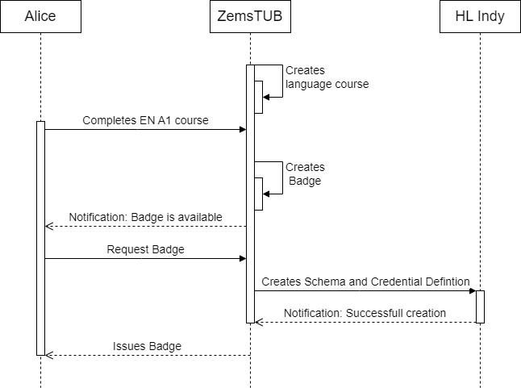
2.1 Ausstellungsprozess
MOODLE PLUGIN FÜR VC | JONAS KRAUSE | 25. SEPTEMBER 2023
Notes:
Slide with text in two columns
Remarks:
Reference lines are like red lines - they must not be crossed (only in some exceptional cases like for pictures with oversize)
Slide is to be built from bottom to top - start with aligning content and pictures at the bottom reference line
Slide title: Helvetica, 45 pt, bold, uppercase (mandatory)
Slide sub-title: Helvetica, 45 pt, uppercase (optional)
normal text in bullet points: Helvetica 30 pts (or larger, but use the same font size on all slides)
titles for bullet points: Helvetica 40 pts (or larger, approx 10pts larger than normal text, but use the same font size on all slides) - titles for bullet points are optional

Slide 5
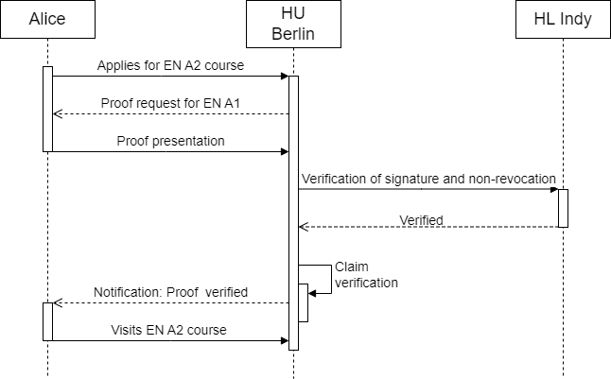
2.2 Verifizierungsprozess
MOODLE PLUGIN FÜR VC | JONAS KRAUSE | 25. SEPTEMBER 2023
Notes:
Slide with text in one column (usually not a good idea)
Remarks:
Reference lines are like red lines - they must not be crossed (only in some exceptional cases like for pictures with oversize)
Slide is to be built from bottom to top - start with aligning content and pictures at the bottom reference line
Slide title: Helvetica, 45 pt, bold, uppercase (mandatory)
Slide sub-title: Helvetica, 45 pt, uppercase (optional)
normal text in bullet points: Helvetica 30 pts (or larger, but use the same font size on all slides)
titles for bullet points: Helvetica 40 pts (or larger, approx 10pts larger than normal text, but use the same font size on all slides) - titles for bullet points are optional

Slide 6
3.1 Demo
MOODLE PLUGIN FÜR VC | JONAS KRAUSE | 25. SEPTEMBER 2023
Notes:
Slide with text in one column (usually not a good idea)
Remarks:
Reference lines are like red lines - they must not be crossed (only in some exceptional cases like for pictures with oversize)
Slide is to be built from bottom to top - start with aligning content and pictures at the bottom reference line
Slide title: Helvetica, 45 pt, bold, uppercase (mandatory)
Slide sub-title: Helvetica, 45 pt, uppercase (optional)
normal text in bullet points: Helvetica 30 pts (or larger, but use the same font size on all slides)
titles for bullet points: Helvetica 40 pts (or larger, approx 10pts larger than normal text, but use the same font size on all slides) - titles for bullet points are optional

